Slide 1
What is Business Continuity (BC) ?
What is business continuity ?
Business Continuity (BC) is the capability of the org to continue delivery of products or services at acceptable predefined levels following a disruptive incident (Source: ISO 22301:2012)
http://www.thebci.org/index.php/resources/what-is-business-continuity

Slide 2
What is Business Continuity (BC) ?
What is business continuity management?
Holistic management process that identifies potential threats to an organization and the impacts to business operations those threats, if realized, might cause, and which provides a …
http://www.thebci.org/index.php/resources/what-is-business-continuity

Slide 3
What is Business Continuity (BC) ?
What is business continuity management?
…framework for building org resilience with an effective response that safeguards interests of key stakeholders, reputation, brand and value-creating activities. (Source: ISO 22301:2012)
http://www.thebci.org/index.php/resources/what-is-business-continuity

Slide 4
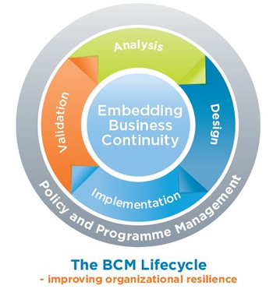
What is Business Continuity (BC) ?
http://www.thebci.org/index.php/resources/what-is-business-continuity

Slide 5
What is Business Continuity (BC) ?
What is a BC plan ?
A document that consists of critical information an organization needs to continue operating during an unplanned event
http://searchdisasterrecovery.techtarget.com/definition/business-continuity-action-plan

Slide 6
What is Business Continuity (BC) ?
What is a BC plan ?
The BCP should state essential functions of the business, identify which systems and processes must be sustained, & detail how to maintain them. It should take into account any possible business disruption
http://searchdisasterrecovery.techtarget.com/definition/business-continuity-action-plan

